Slide 1

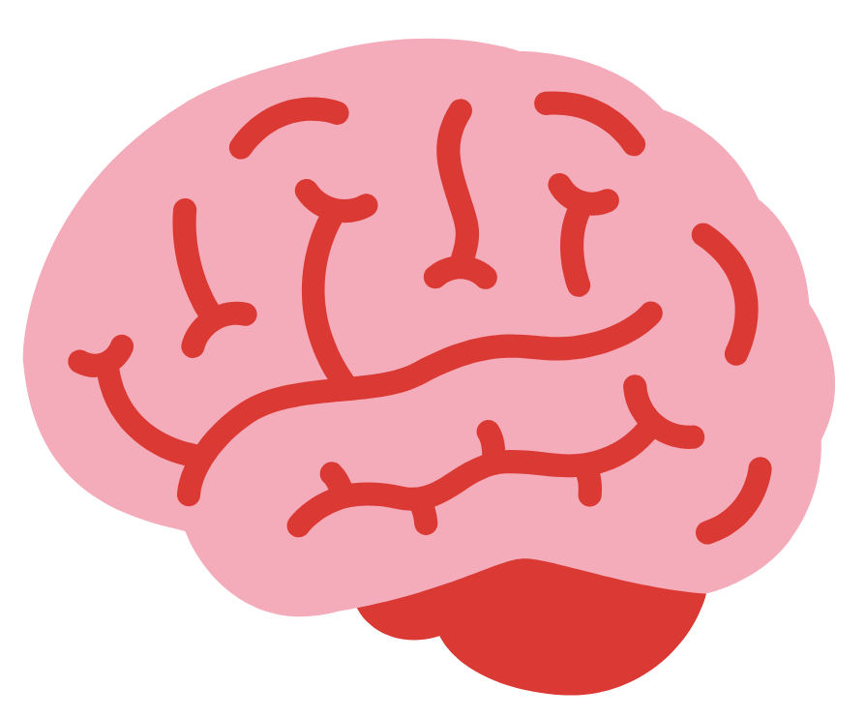
Definition
“Intelligence is the ability to learn from experience, solve problems, and use our knowledge to adapt to new situations”

Slide 3
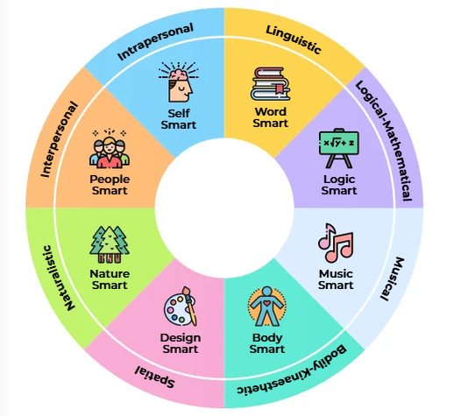
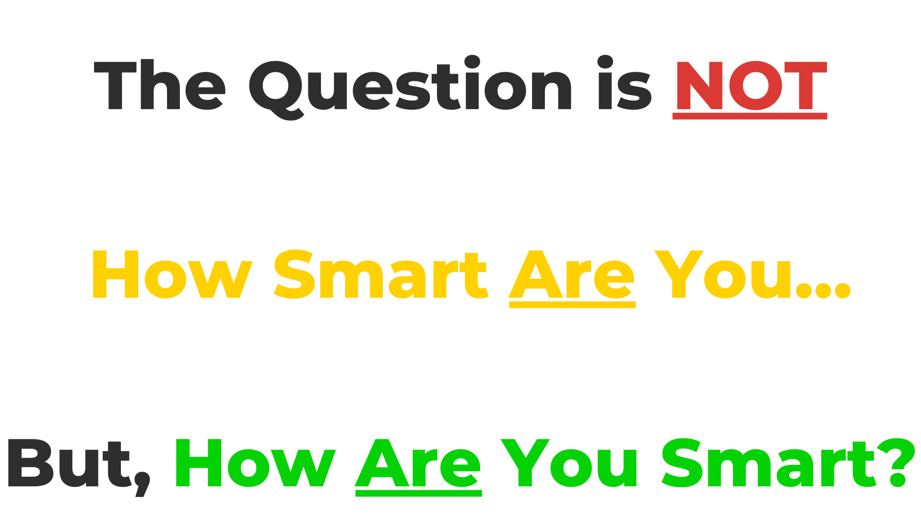
Multiple Intelligences

Slide 4
What is Intelligence?
You may have heard of a person’s IQ – a score that is supposed to tell you how intelligent a person is. Really brainy people would often boast that they have a high IQ – usually just annoying everyone else in the room – which, oddly enough, is not very intelligent!
Intelligence Tests (IQ Tests) score people on a variety of activities and creates a profile of a person’s abilities, similar to an aptitude test.
The modern theory of ‘multiple intelligences’ offers a broader perspective on intelligence. It helps us to understand how we learn best and why we are interested in some things more than others.
Nowadays, people find it more suitable to ask “how are you intelligent?” rather than “how intelligent are you?”
The good news is that we all have multiple intelligences!

Slide 5
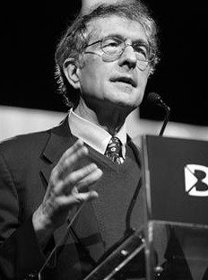
What is the Theory of
Multiple Intelligences?
Howard Gardner's theory of multiple intelligences proposes that people are not born with all of the intelligence they will ever have.
This theory challenged the traditional idea that there is one single type of intelligence, General Intelligence.
To broaden his idea of intelligence, Gardner introduced 8 different types of intelligences

Slide 6
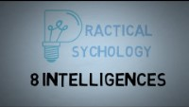
Short Video on MI

Slide 7
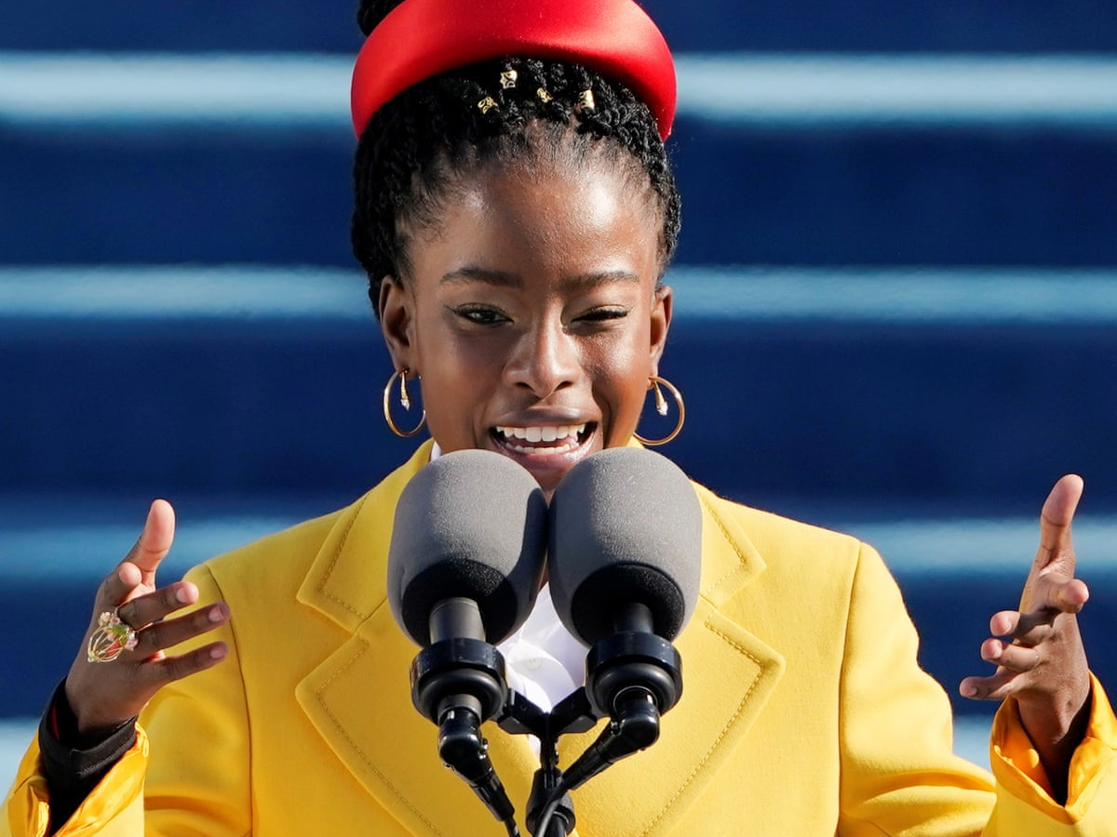
Linguistic-Verbal
Good with Words – ‘Word Smart’
People with linguistic intelligence have well-developed verbal skills and sensitivity to the sounds and meanings of words.
Careers related to this Intelligence:
Speech and Language Therapist
Writer
Journalist
Lawyer
Language Teacher
Politician
Poet
Famous People:
Amanda Gorman, Roald Dahl and Maeve Binchy.
What it means?
Linguistic intelligence means to have a deep understanding and appreciation of words and the use of language. It is the most widely shared human competence and is evident in people who enjoy writing or speaking.
Those with this kind of intelligence enjoy writing, reading, taking notes, researching, telling stories or doing crossword puzzles.

Slide 8
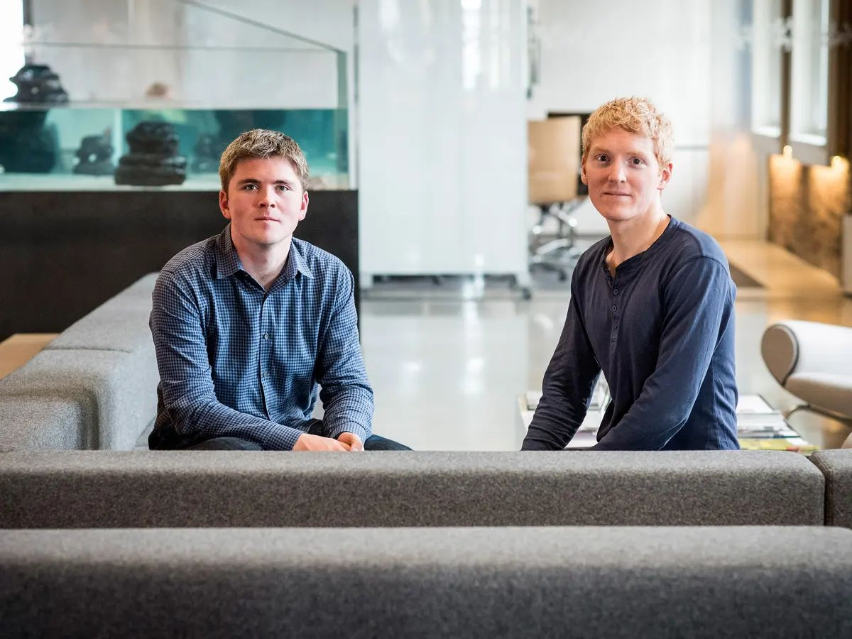
2. Logical-Mathematical
Good with Mathematics and Logic – ‘Number Smart’
Logical-mathematical intelligence is the ability to calculate, quantify and handle logical thinking and problem solving.
Careers related to this Intelligence:
Computer Programmer
Accountant
Engineer
Scientist
Mathematician
Auditor
Economist
Famous People:
Collison Brothers (Stripe), Albert Einstein and Marie Curie.
What it means?
Logical-mathematical intelligence is an ability to understand numbers, concepts and to have excellent reasoning skills. It is usually evident in people who enjoy numbers, data and statistics.
People with this intelligence are interested in patterns, mathematical problems, brainstorming, investigating, computers and programming.

Slide 9
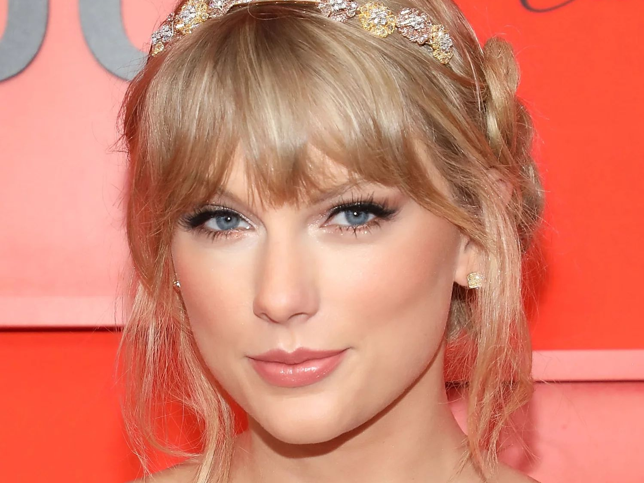
Careers related to this Intelligence:
Disc jockey - D.J.
Instrument Maker
Songwriter
Conductor
Singer
Music Teacher
Sound Technician
Famous People:
Taylor Swift, Dermot Kennedy and Beyoncé.
3. Musical
Good with Rhythm – ‘Music Smart’
Musical intelligence is the ability to tell the difference between pitch, rhythm and tone.
What it means?
This intelligence enables us to recognize, create, reproduce, and reflect on music. It is usually well developed and evident in people who have a passion for listening to and playing music.
People with this kind of intelligence are usually quite aware of sounds and techniques that others often miss. They enjoy creating music and going to concerts.

Slide 10
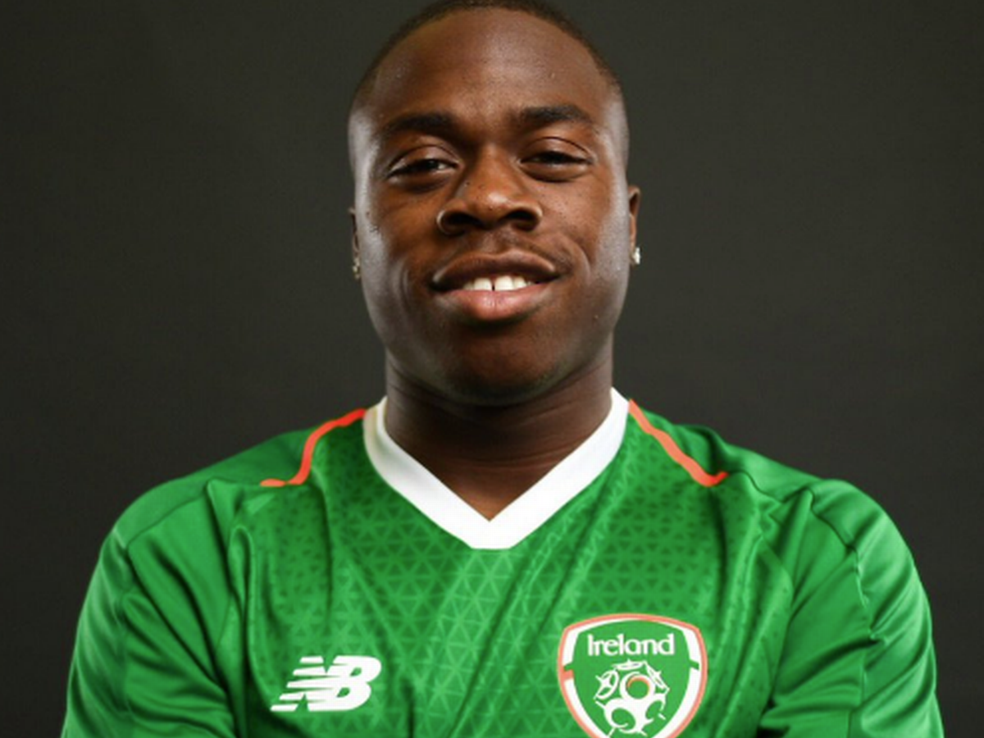
Careers related to this Intelligence:
Physical Therapist
Dancer
Actor
Craftsperson
Physical Education Teacher
Athlete
Football Player
Famous People:
Michael Obafemi, Katie Taylor and Johnny Sexton.
4. Bodily-Kinaesthetic
Good with Activities – ‘Body Smart’
Bodily-Kinaesthetic people have excellent coordination, dexterity and motor skills.
What it means?
This intelligence involves a sense of timing and the perfection of skills such as hand-eye coordination. Athletes, dancers, surgeons, and craftspeople exhibit well-developed bodily-kinaesthetic intelligence.
Young adults with this intelligence usually enjoy playing sports, dancing, making things, crafts and fashion.

Slide 11
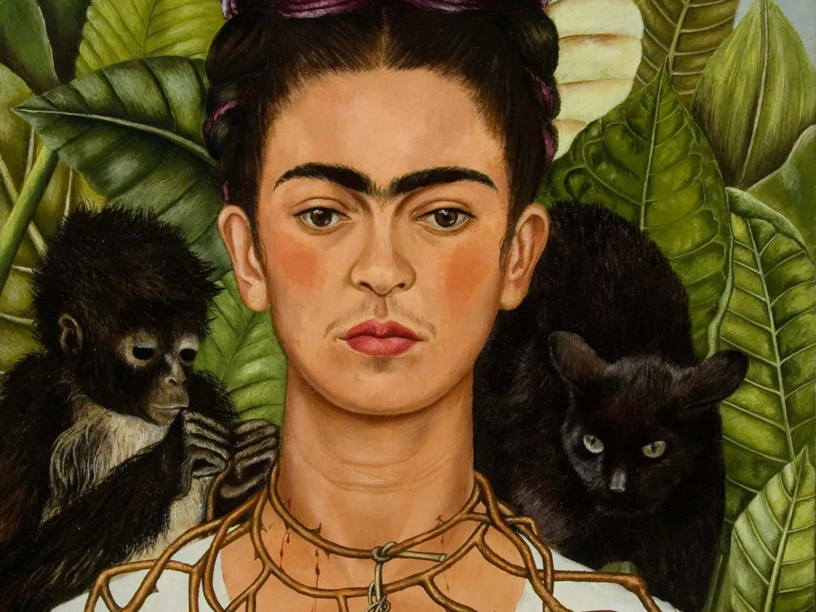
Careers related to this Intelligence:
Surveyor
Architect
Urban Planner
Photographer
Art Teacher
Fine Artist
Sculptor
Famous People:
Frida Kahlo, Leonardo da Vinci and Dermot Bannon.
5. Spatial-Visual
Good with Art and Design – ‘Design Smart’
Spatial intelligence is the ability to think artistically and in three dimensions.
What it means?
To have these skills means that you have the ability to interpret images and shapes, possess graphic and artistic skills, and an active imagination.
Young adults with this kind of intelligence may be fascinated with mazes or jigsaw puzzles and spend their free time doing activities such as drawing or repairing machinery.

Slide 12
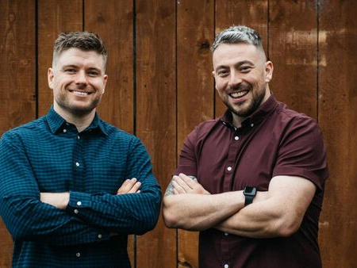
Careers related to this Intelligence:
Manager
School Principal
Personnel Worker
Politician
Counsellor
Psychologist
Nurse
Famous People:
The 2 Johnnies, Mary Robinson and Barack Obama.
6. Interpersonal
Good with Communication – ‘People Smart‘
Interpersonal intelligence is the ability to understand and interact very well with others.
What it means?
It involves excellent verbal and non-verbal communication skills, as well as being sensitive to the moods and temperaments of others.
Those with this kind of intelligence may be extroverted. They are leaders and are comfortable in social situations.

Slide 13
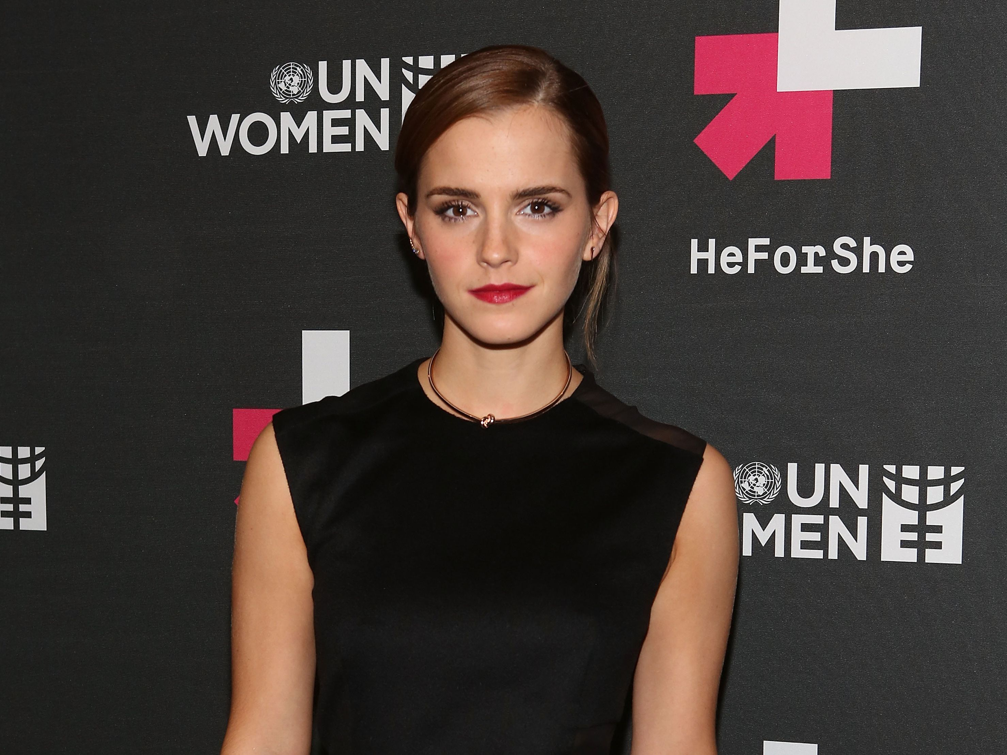
7. Intrapersonal
Good at Self-Reflection – ‘Self Smart’
Intrapersonal intelligence is the capacity to understand yourself; your thoughts and feelings, and to use this knowledge to guide you.
Careers related to this Intelligence:
Psychologist
Member of the Clergy
Psychologist
Therapist
Counsellor
Theologian
Entrepreneur
Famous People:
Emma Watson, Gandhi, and Anne Frank.
What it means?
People with intrapersonal intelligence know themselves well. They are tuned into their dreams, goals, moods, strengths and limitations.
People with this kind of intelligence may be introverted. They are very aware of their own feelings, are self-motivated and make decisions based on what is right for them.

Slide 14
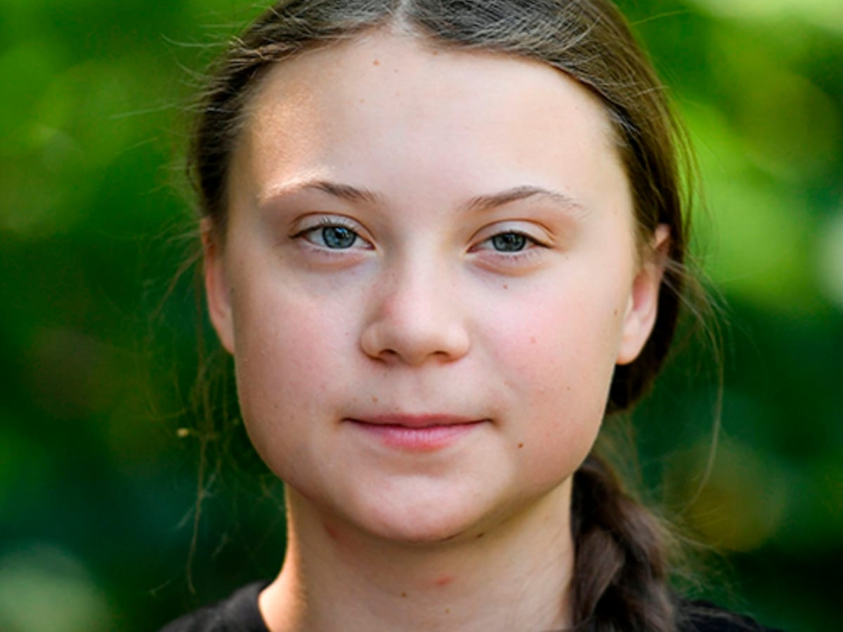
Careers related to this Intelligence:
Astronomer
Botanist
Vet
Climate Activist
Gardener
Farmer
Zoologist
Famous People:
Greta Thunberg, David Attenborough and Jane Goodall.
8. Naturalistic
Good with Understanding Natural World – ‘Nature Smart’
The Naturalist is sensitive towards nature and the world around them.
What it means?
People with this intelligence have the ability to observe patterns in nature, have a love of being outdoors and are very interested in protecting the environment.
People with this intelligence usually enjoy camping, gardening, hiking, exploring the outdoors and caring for the world around them.

Slide 15

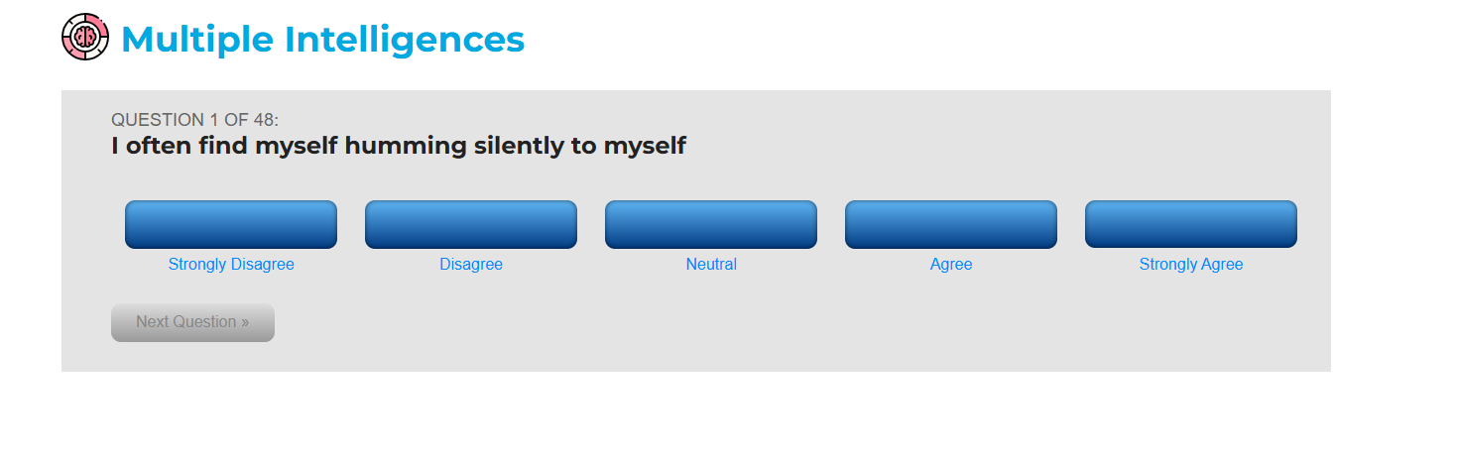
Step 1: Click on the Multiple Intelligences app
Step 2: Go through the Quiz by clicking on the answer that describes you best

Slide 16
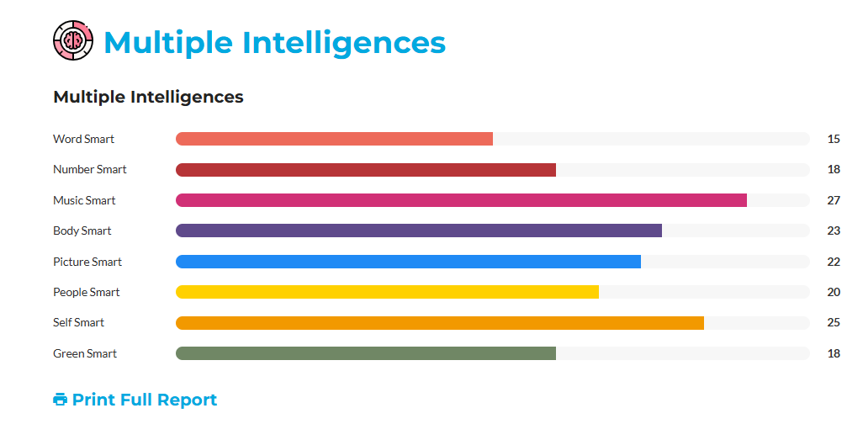
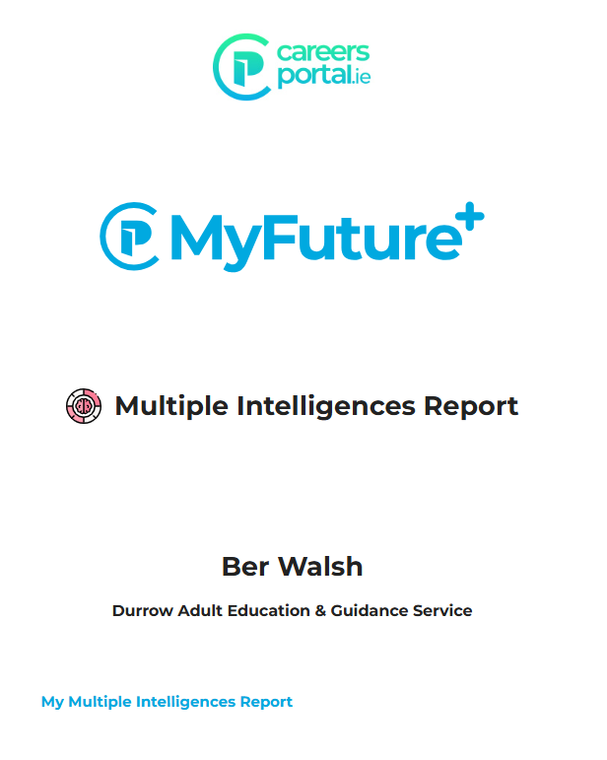
At the end of the on-line questionnaire you will find out your Top MI Type is. You will see a graph and can print or save a PDF report.

Slide 17


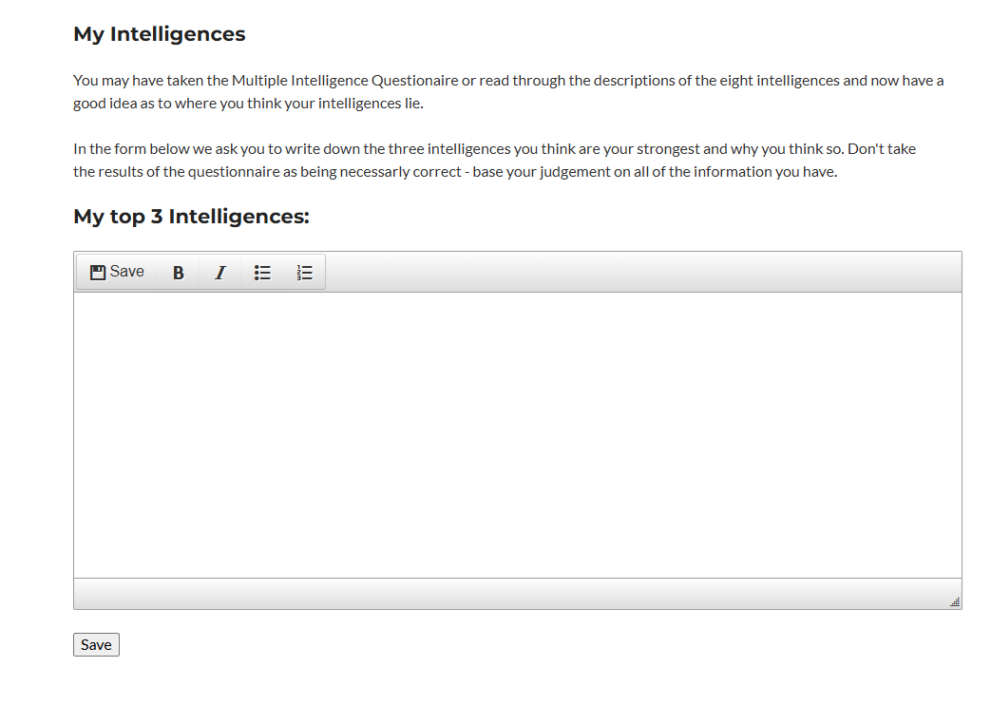
Exercise: Multiple Intelligences Reflection
It is important to include your thoughts and learning on your results and how these match to career areas:

Slide 18
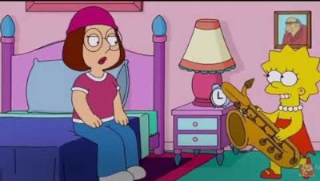
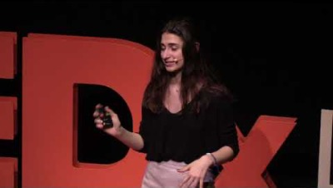
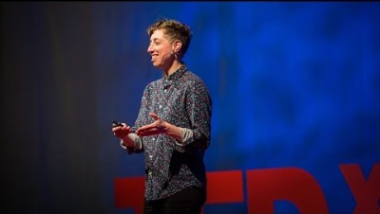
Videos:
5-minute video explaining Gardner's Multiple Intelligences Theory with fictional TV and Movie Characters.
6-minute Ted Talk video. Writer and artist Emilie Wapnick describes the kind of people she calls "multipotentialites”.
12-minute Ted Talk video. Celeste Tomaselli explains how Gardner's Theory of Multiple Intelligences can empower young people to use their unique talents to make the world a better place.

Slide 19
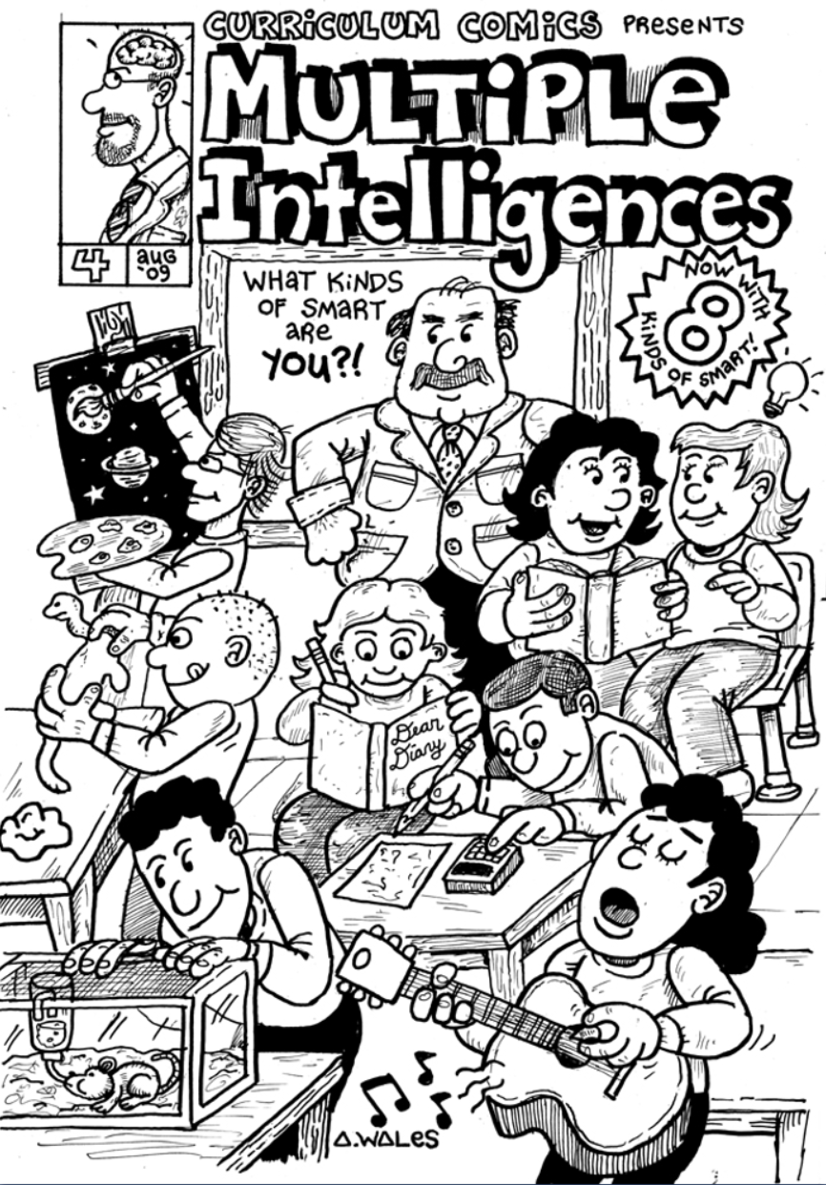
Understand a definition of ‘intelligence’
You can identify the 8 multiple intelligences
You can identify a famous person under each ‘intelligence’
You will complete the self-assessment quiz and have increased awareness of their top intelligences
You will be able to identify career areas and some occupations that match the results of your top intelligences

